Slide 1
Graphs

Slide 2
Outline
Graphs
Definition
Types
2

Slide 3
Definition
Like Trees, Graphs are also considered non-linear data structures
A Graph has vertices and edges and normally represented as
G = (V, E)
3

Slide 4
Definition
A pair of object in which order matters is called an Ordered pair
(a, b) != (b, a) if a != b
A pair of object in which order does not matter is called unordered pair
{a, b} = {b, a}
4

Slide 5
Definition
V = {A, B, C, D, E, F}
5

Slide 6
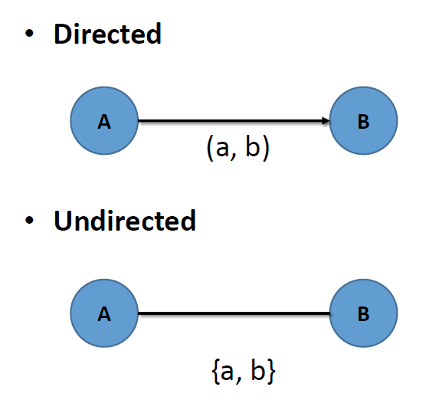
Edges
6

Slide 7
Edges
E = {{A, B}, {A, C}, {A, D}, {B, C}, {B, E}, {D, E}, {D, F}}
7

Slide 8
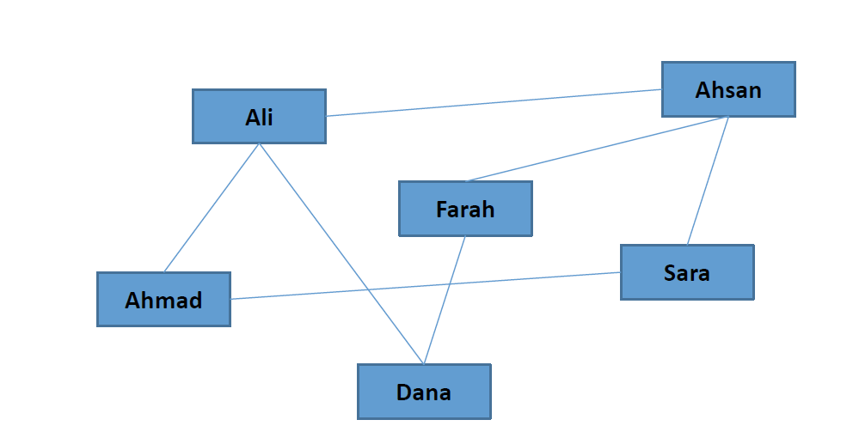
Example (Social Networking)

Slide 9
Weighted and Unweighted Graph
A graph in which edges have weights is called a weighted graph
9

Slide 10
Weighted and Unweighted Graph
A graph in which edges have weight = 1 is unweighted graph
10

Slide 11
Wrap-up
Graphs
Definition
Types
11

